Slide 1


EEE 414 Electrical Services Design Project Demonstration
Presented To
Asikur Rahman Jowel
Ihtesam Ibn Malek
Mohammad Ali
Presented By
Section : C Group : 08
Shafim Bin Hassan | 1706172
Subah Karnine | 1706174
Farhan Hamid | 1706175
Swapneel Sen | 1706185
Shahriar Kabir Nahin | 1706186
Md. Mehedi Hasan Munna | 1706187
Tanisha Tanzina Hasan | 1706188
Joy Saha | 1706189

Slide 2
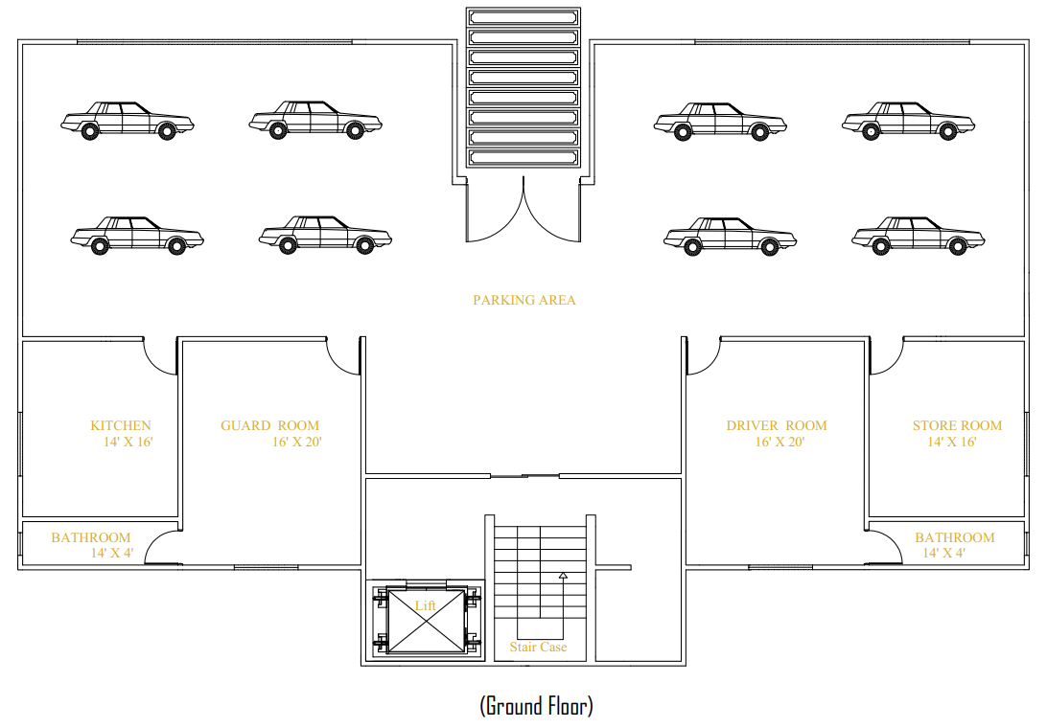
Ground Floor Plan
Ground
Floor
Parking Area
Driver Room
&
Bathroom
Guard Room
&
Bathroom
Kitchen
Store Room
Project Group 8

Slide 3
Unit Description (First to Fifth Floor)
Unit-1
Unit-2
Unit
Master Bedroom
(1)
Dining Room
Drawing Room
Common Bathroom
(1)
Normal Bedroom
(2)
Entrance
Project Group 8

Slide 4
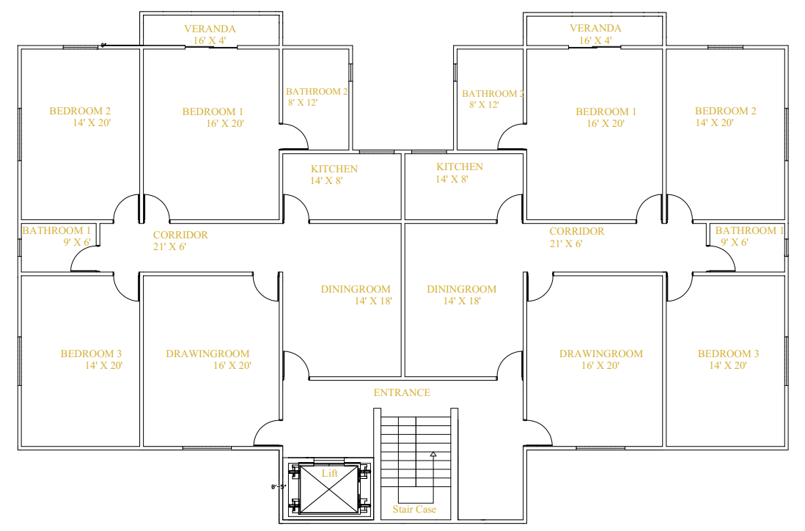
First to Fifth Floor Plan
Project Group 8

Slide 5

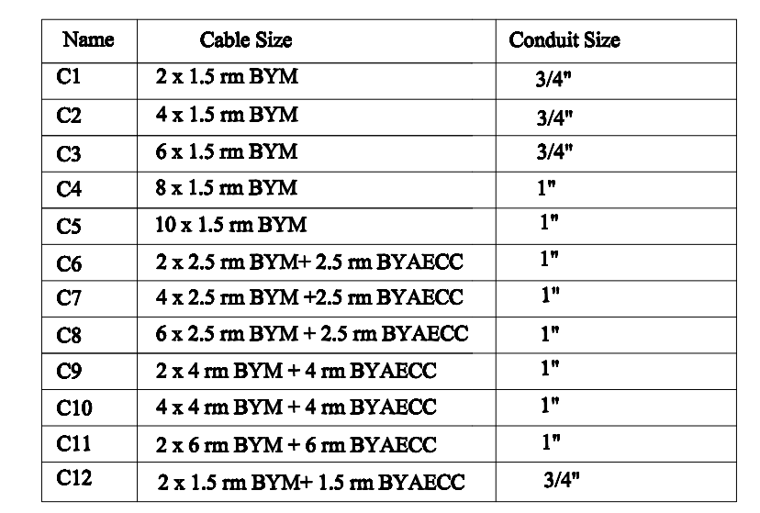
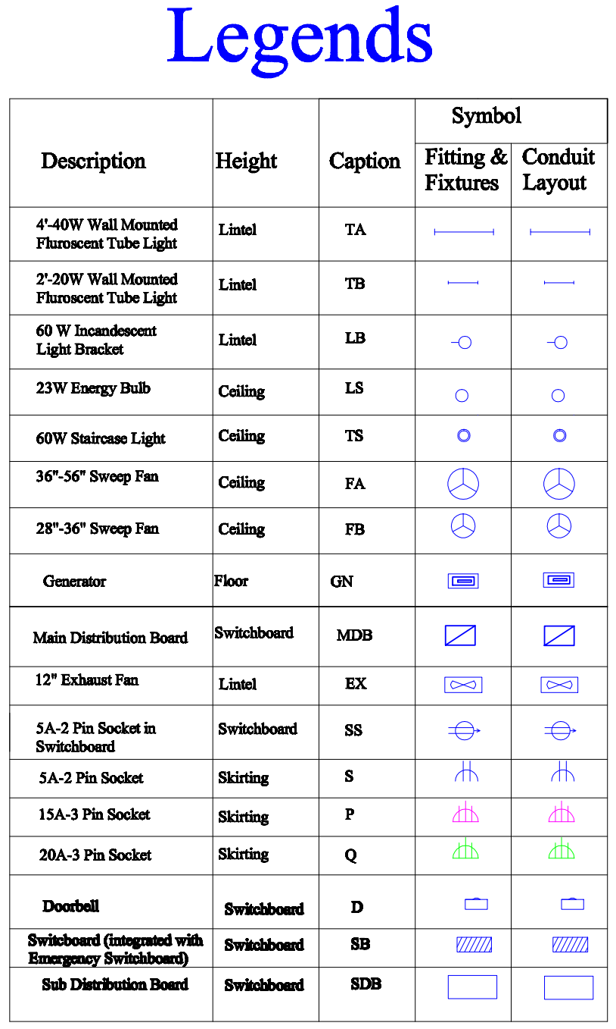

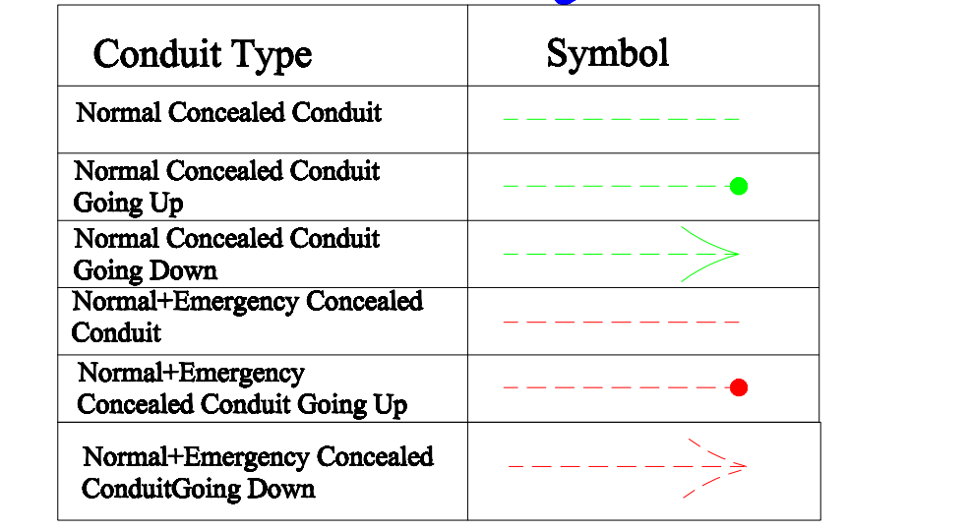
Project Group 8

Slide 6
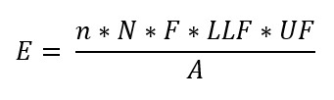
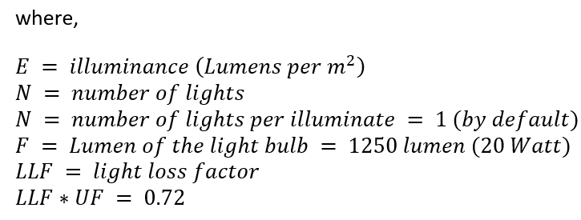
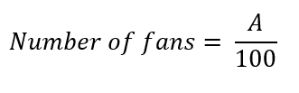

Calculations for Fixtures and Fittings
Formula for light bulbs:
n
=1300
= 0.8
Formula for fans:
One 56” diameter fan is needed every 100 sq feet.
Project Group 8

Slide 7
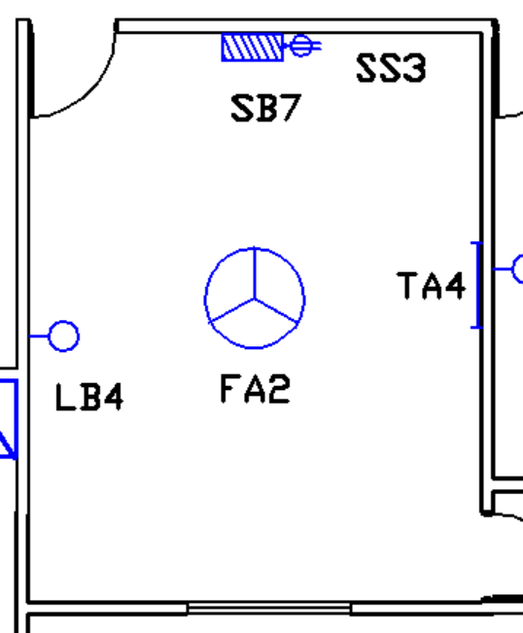
Calculations for Fixtures and Fittings
Example Calculation for Guard/Driver Bedroom:
Area, A = 16 * 20 sq ft = 320 sq ft = 29.7289728 m^2
E = 100 lumen/m^2
LLF x UF = 0.8
n = 1
Flux = 1300 lumen
From calculation,
Number of lights, N = 2.85
So, 2 Light Bulbs and 1 Tube Light are needed.
But, to preserve power consumption, 1 light bulb(LB) and 1 tube light(TA) are set.
Number of fans = 320/ 100 = 3.2
So, 3 fans are needed, but to preserve power consumption, 1 ceiling fan(FA) is set.
Project Group 8

Slide 8
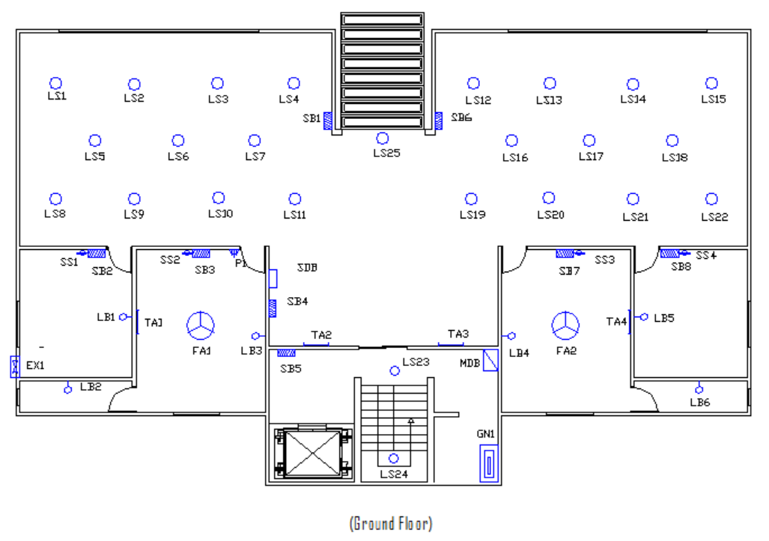
Fittings and Fixtures (Ground Floor)
Project Group 8

Slide 9
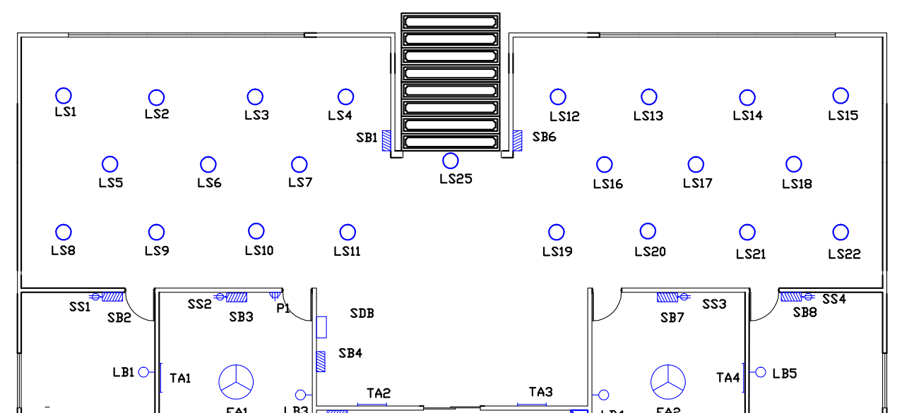
Fittings and Fixtures (Ground Floor)
Parking space:
Suggested: 19 LS
Project Group 8

Slide 10
Summarized Fixtures and Fittings (Ground Floor)
Room | Number of Lights |  |  |  |  | Number of fans
Kitchen |  |  |  | 1LB |  |  |  | 1EX
Guard room | 1TA |  |  | 1LB |  | 1FA
Bathroom |  |  |  | 1LB
Parking |  |  |  |  | 23LS
Stair Case |  |  |  |  | 2LS
Store room |  |  |  | 1LB
Driver Room | 1TA |  |  | 1LB
Project Group 8

Slide 11
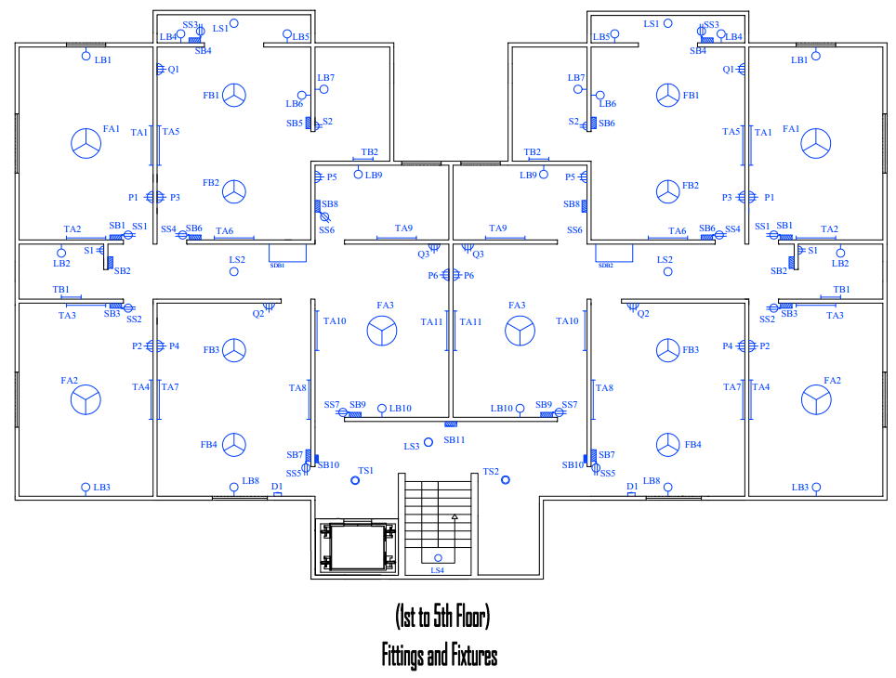
Fittings and Fixtures (First to Fifth Floor)
Project Group 8

Slide 12
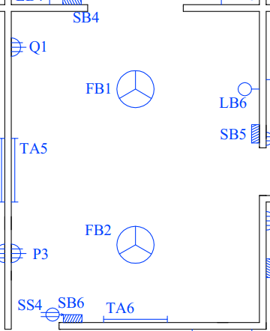
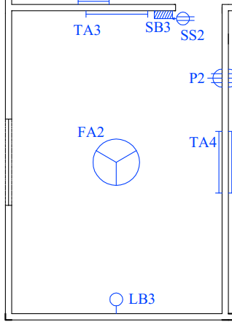
Fittings and Fixtures (First and Fifth Floor)
Bedroom 1 and Drawing Room:
Bedrooms 2 and 3:
Suggested: 2TA, 1LB, 2FB
Suggested: 2TA, 1LB, 1FA
Project Group 8

Slide 13
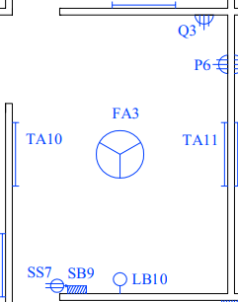
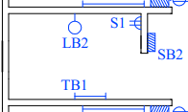
Fittings and Fixtures (First and Fifth Floor)
Dining room:
Bathroom 1:
Suggested: 1TB, 1LB
Suggested: 2TA, 1LB, 1FA
Project Group 8

Slide 14
Summarized Fixtures and Fittings (1st and 5th Floor)
Room | Number of Lights |  |  |  |  | Number of fans
Bedroom 1 | 2TA |  |  | 1LB |  | 2FA
Drawing Room | 2TA |  |  | 1LB |  | 2FA
Bedroom 2 | 2TA |  |  | 1LB |  |  | 1FA
Bedroom 3 | 2TA |  |  | 1LB |  |  | 1FA
Dining Room | 2TA |  |  | 1LB |  | 1FA
Corridor |  |  |  |  | 1LS
Kitchen | 1TA |  |  | 1LB
Toilet 1 |  | 1TB |  | 1LB
Toilet 2 |  | 1TB |  | 1LB
Veranda |  |  |  | 2LB | 1LS
Staircase |  |  | 2TS |  | 2LS
Project Group 8

Slide 15
Conduit Schedules
Project Group 8

Slide 16
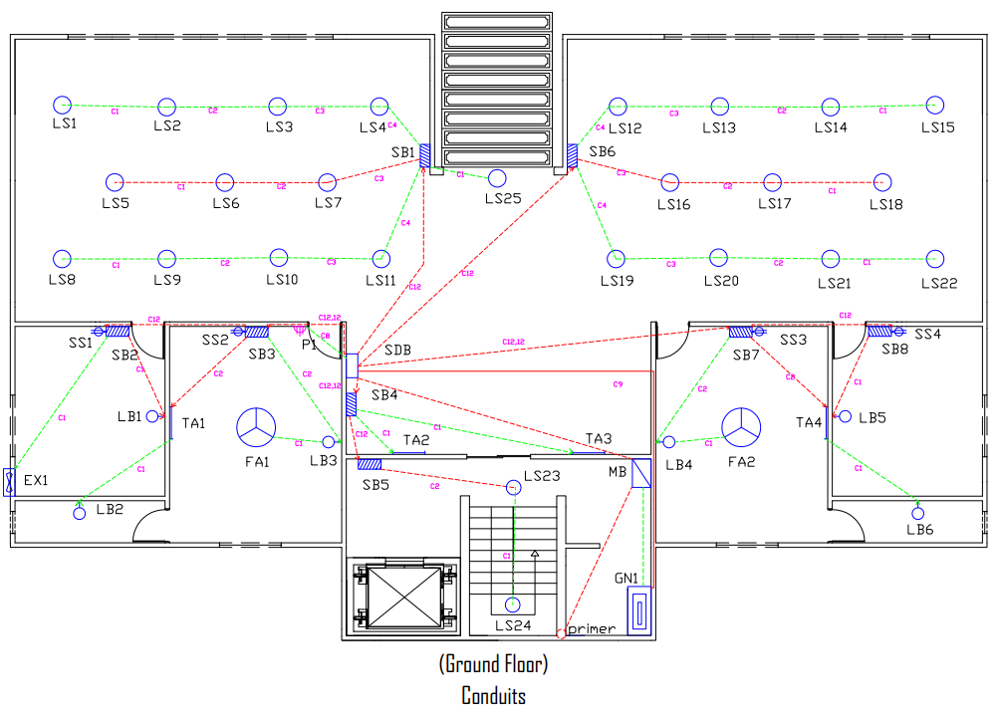
Conduit (Ground Floor)
Project Group 8

Slide 17
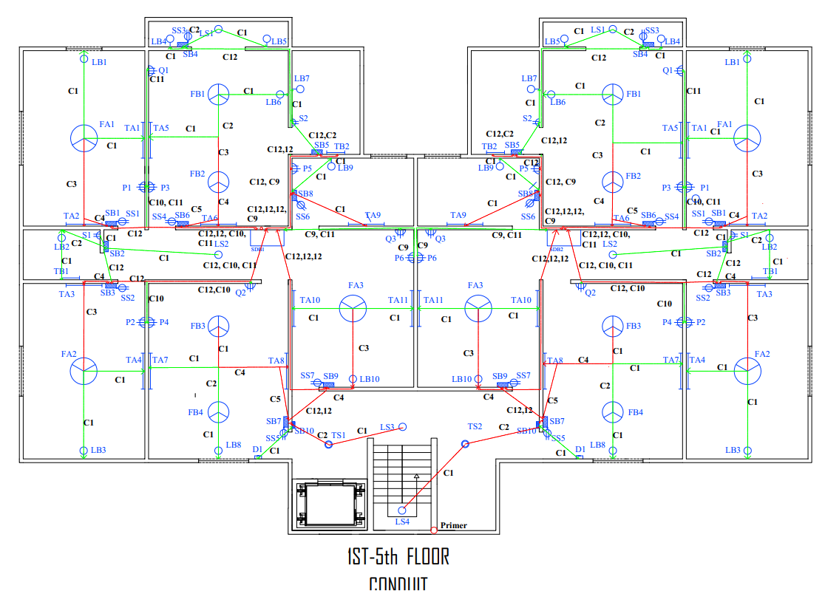
Conduit (First to Fifth Floor)
Project Group 8

Slide 18
Calculations
Rated Powers:
Utility | Load
TA | 40 W
TB | 20 W
LB | 60 W
LS | 23 W
TS | 60 W
SS | 100 W
FA | 100 W
FB | 75 W
S | 100 W
D | 50 W
Project Group 8

Slide 19
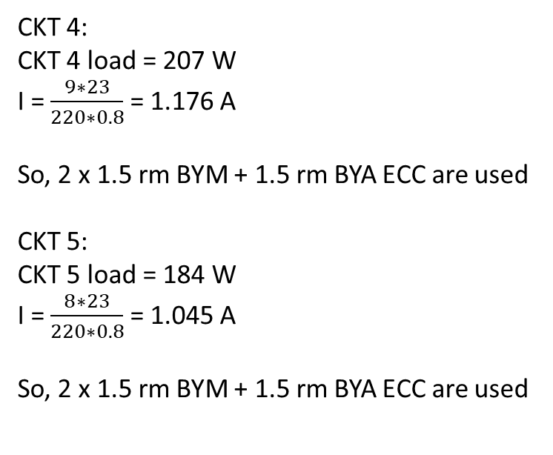
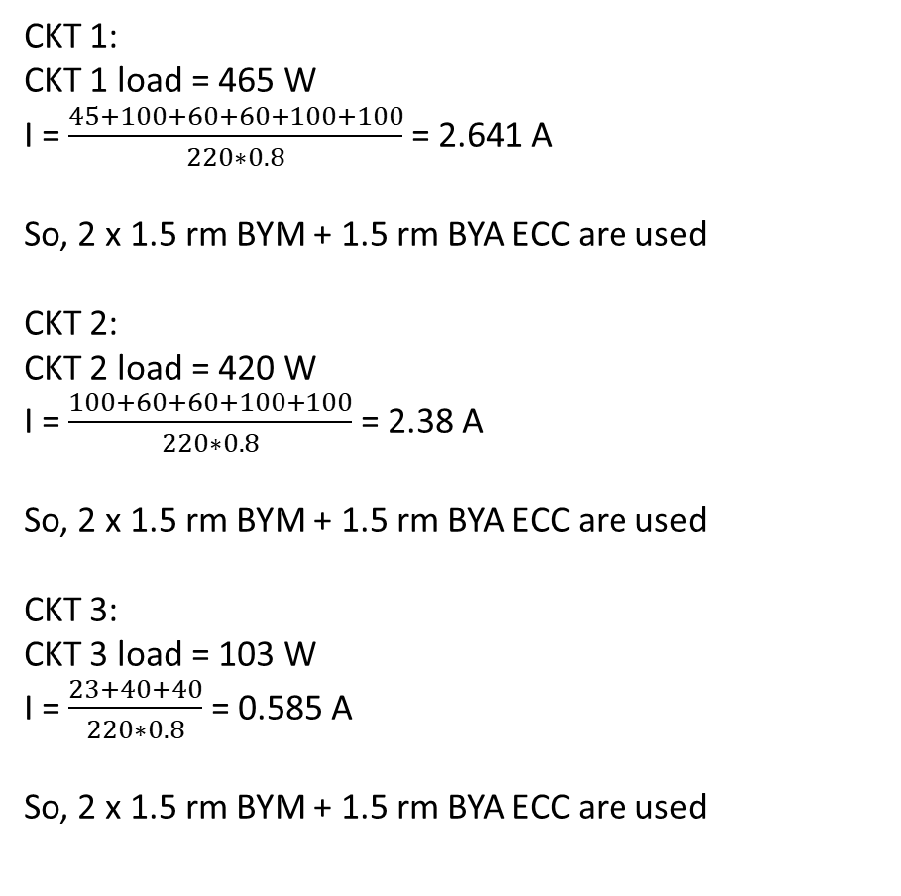
Calculations for Switchboards (Ground Floor):
CKT 1:
CKT 1 load = 465 W
I = $\frac{45+100+60+60+100+100}{220∗0.8}$ = 2.641 A
So, 2 x 1.5 rm BYM + 1.5 rm BYA ECC are used
CKT 2:
CKT 2 load = 420 W
I = $\frac{100+60+60+100+100}{220∗0.8}$ = 2.38 A
So, 2 x 1.5 rm BYM + 1.5 rm BYA ECC are used
CKT 3:
CKT 3 load = 103 W
I = $\frac{23+40+40}{220∗0.8}$ = 0.585 A
So, 2 x 1.5 rm BYM + 1.5 rm BYA ECC are used
CKT 4:
CKT 4 load = 207 W
I = $\frac{9∗23}{220∗0.8}$ = 1.176 A
So, 2 x 1.5 rm BYM + 1.5 rm BYA ECC are used
CKT 5:
CKT 5 load = 184 W
I = $\frac{8∗23}{220∗0.8}$ = 1.045 A
So, 2 x 1.5 rm BYM + 1.5 rm BYA ECC are used
Project Group 8

Slide 20
Summary of Switchboard Calculations (Ground Floor)
Circuit | Current | Conduit
1 | 2.641 A | 2 x 1.5rm BYM + 1.5 BYA ECC
2 | 2.38 A | 2 x 1.5rm BYM + 1.5 BYA ECC
3 | 0.795 A | 2 x 1.5rm BYM + 1.5 BYA ECC
4 | 1.023 A | 2 x 1.5rm BYM + 1.5 BYA ECC
5 | 0.909 A | 2 x 1.5rm BYM + 1.5 BYA ECC
Emergency:
Circuit | Current | Conduit
1 | 0.57 A | 2 x 1.5rm BYM + 1.5 BYA ECC
2 | 0.57 A | 2 x 1.5rm BYM + 1.5 BYA ECC
3 | 0.13 A | 2 x 1.5rm BYM + 1.5 BYA ECC
4 | 0.39 A | 2 x 1.5rm BYM + 1.5 BYA ECC
5 | 0.39 A | 2 x 1.5rm BYM + 1.5 BYA ECC
Project Group 8

Slide 21
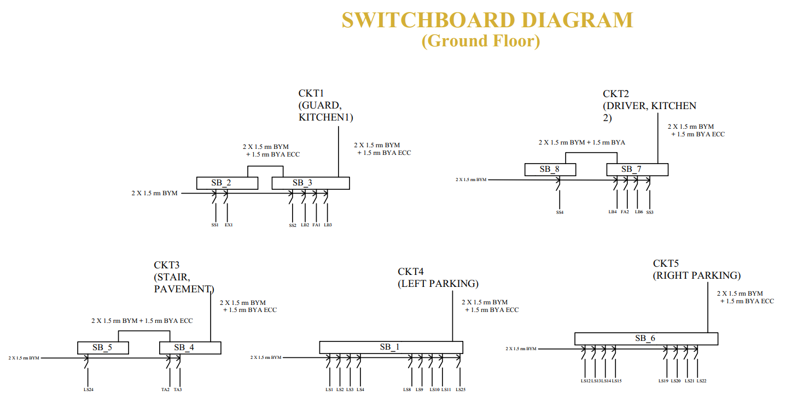
Project Group 8

Slide 22
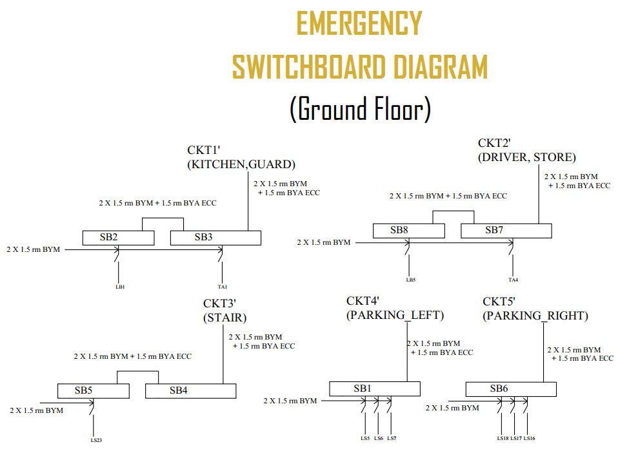
Project Group 8

Slide 23
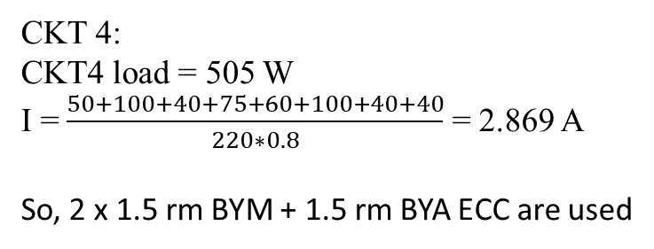
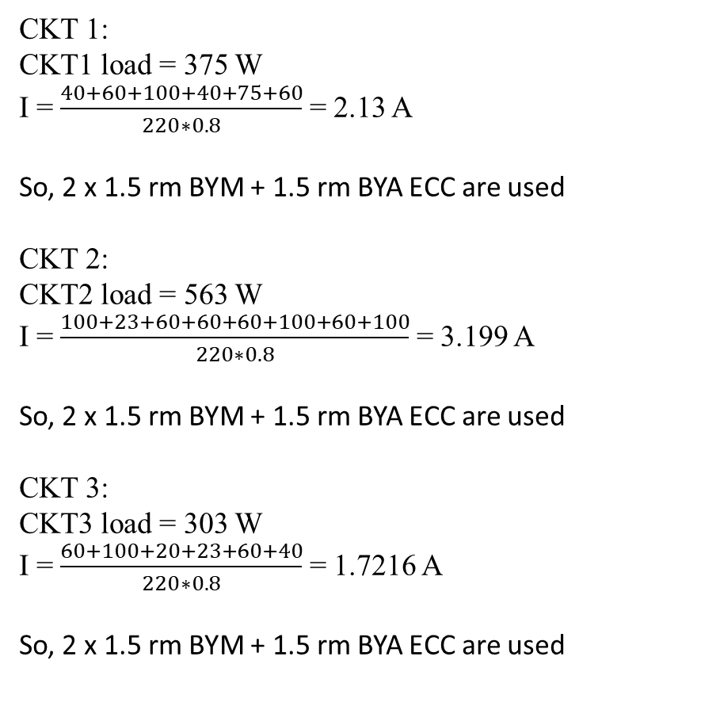
Calculations for Switchboards (1st to 5th Floor):
CKT 1: CKT1 load = 375 W
I = $\frac{40+60+100+40+75+60}{220∗0.8}$ = 2.13 A
So, 2 x 1.5 rm BYM + 1.5 rm BYA ECC are used
CKT 2:
CKT2 load = 563 W
I = $\frac{100+23+60+60+60+100+60+100}{220∗0.8}$ = 3.199 A
So, 2 x 1.5 rm BYM + 1.5 rm BYA ECC are used
CKT 3:
CKT3 load = 303 W
I = $\frac{60+100+20+23+60+40}{220∗0.8}$ = 1.7216 A
So, 2 x 1.5 rm BYM + 1.5 rm BYA ECC are used
CKT 4:
CKT4 load = 505 W
I = $\frac{50+100+40+75+60+100+40+40}{220∗0.8}$ = 2.869 A
So, 2 x 1.5 rm BYM + 1.5 rm BYA ECC are used
Project Group 8

Slide 24
Summary of Switchboard Calculations (1st to 5th Floor)
Circuit | Current | Conduit
1 | 2.13 A | 2 x 1.5rm BYM + 1.5 BYA ECC
2 | 3.199 A | 2 x 1.5rm BYM + 1.5 BYA ECC
3 | 1.7216 A | 2 x 1.5rm BYM + 1.5 BYA ECC
4 | 2.869 A | 2 x 1.5rm BYM + 1.5 BYA ECC
Emergency:
Circuit | Current | Conduit
1 | 2.17 A | 2 x 1.5rm BYM + 1.5 BYA ECC
2 | 0.341 A | 2 x 1.5rm BYM + 1.5 BYA ECC
3 | 1.364 A | 2 x 1.5rm BYM + 1.5 BYA ECC
4 | 2.034 A | 2 x 1.5rm BYM + 1.5 BYA ECC
Project Group 8

Slide 25
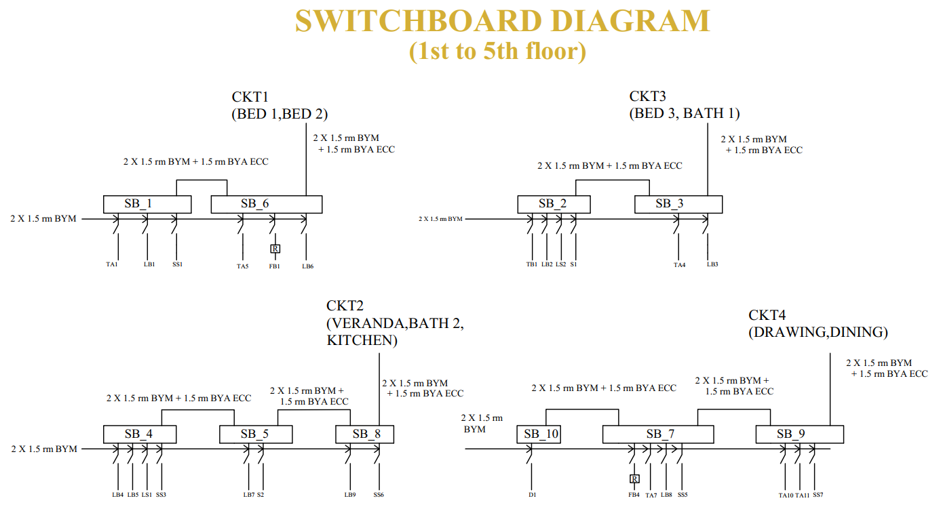
Project Group 8

Slide 26
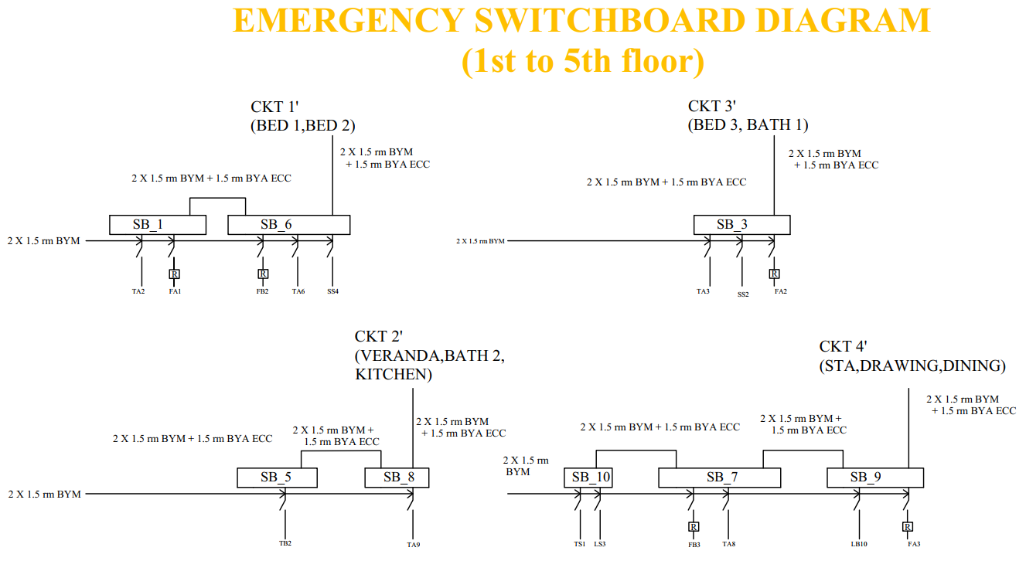
Project Group 8

Slide 27
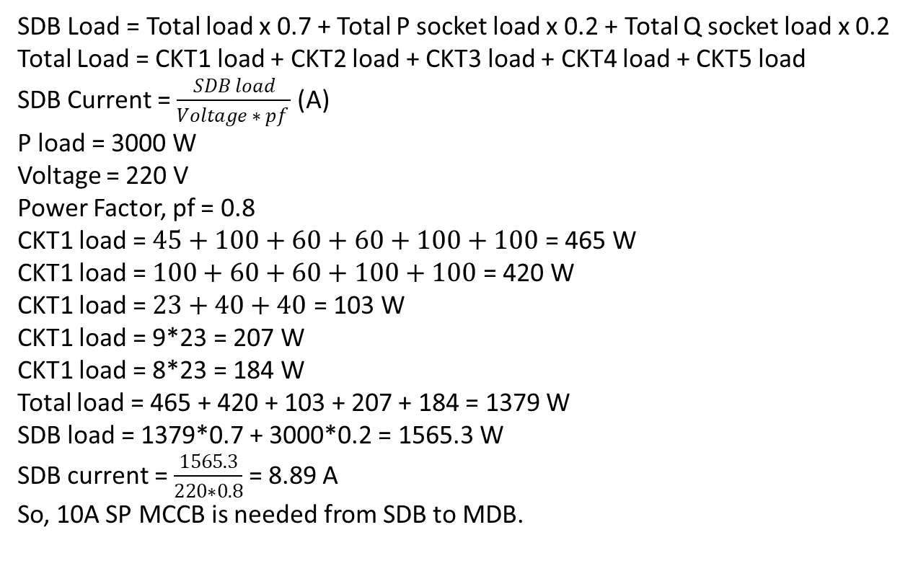
Calculations for SDB (Ground Floor):
SDB Load = Total load x 0.7 + Total P socket load x 0.2 + Total Q socket load x 0.2
Total Load = CKT1 load + CKT2 load + CKT3 load + CKT4 load + CKT5 load
SDB Current = $\frac{SDB load}{Voltage ∗ pf }$ (A)
P load = 3000 W
Voltage = 220 V
Power Factor, pf = 0.8
CKT1 load = $45+100+60+60+100+100$ = 465 W
CKT1 load = $100+60+60+100+100$ = 420 W
CKT1 load = $23+40+40$ = 103 W
CKT1 load = 9*23 = 207 W
CKT1 load = 8*23 = 184 W
Total load = 465 + 420 + 103 + 207 + 184 = 1379 W
SDB load = 1379*0.7 + 3000*0.2 = 1565.3 W
SDB current = $\frac{1565.3}{220∗0.8}$ = 8.89 A
So, 10A SP MCCB is needed from SDB to MDB.
Project Group 8

Slide 28
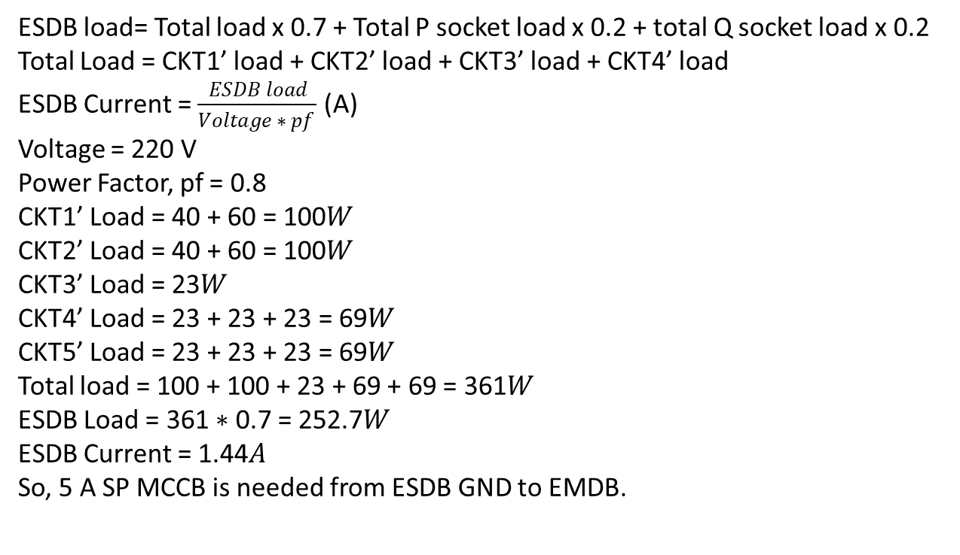
Calculations for ESDB (Ground Floor):
ESDB load= Total load x 0.7 + Total P socket load x 0.2 + total Q socket load x 0.2
Total Load = CKT1’ load + CKT2’ load + CKT3’ load + CKT4’ load
ESDB Current = $\frac{ESDB load}{Voltage ∗ pf }$ (A)
Voltage = 220 V
Power Factor, pf = 0.8
CKT1’ Load = 40 + 60 = 100𝑊
CKT2’ Load = 40 + 60 = 100𝑊
CKT3’ Load = 23𝑊
CKT4’ Load = 23 + 23 + 23 = 69𝑊
CKT5’ Load = 23 + 23 + 23 = 69𝑊
Total load = 100 + 100 + 23 + 69 + 69 = 361𝑊
ESDB Load = 361 ∗ 0.7 = 252.7𝑊
ESDB Current = 1.44𝐴
So, 5 A SP MCCB is needed from ESDB GND to EMDB.
Project Group 8

Slide 29
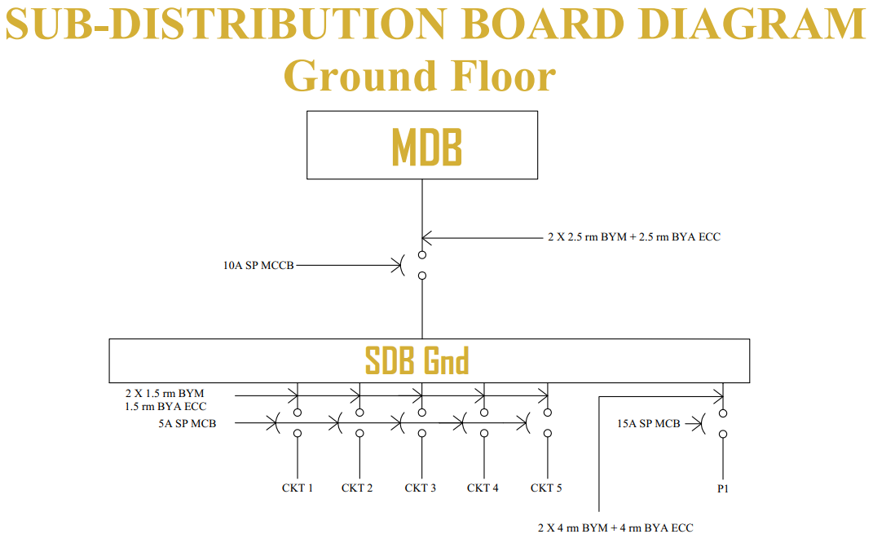
Project Group 8

Slide 30
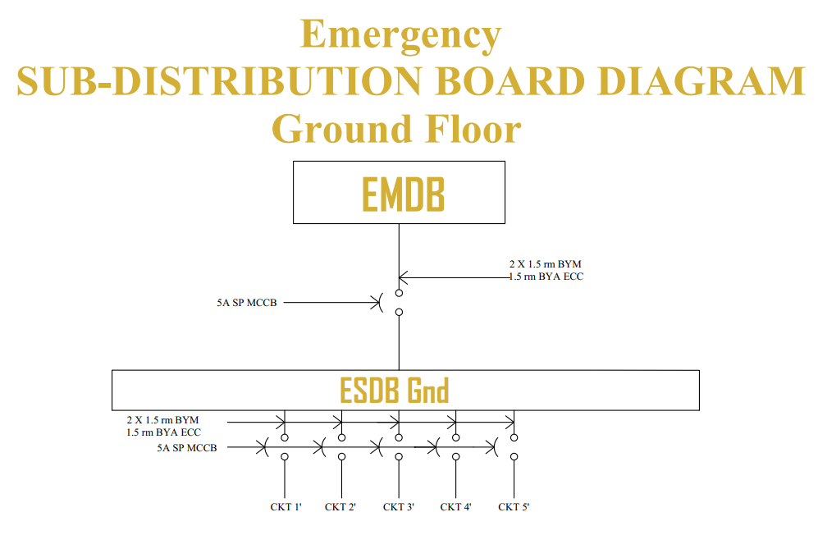
Project Group 8

Slide 31
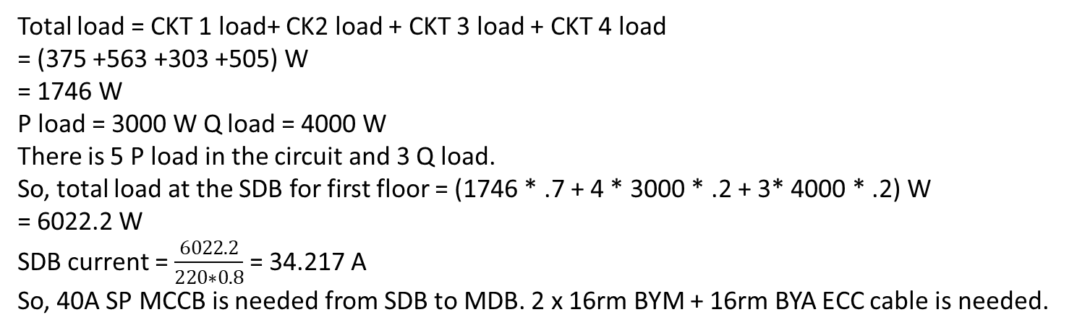
Calculations for SDB (1st to 5th Floor)
Total load = CKT 1 load+ CK2 load + CKT 3 load + CKT 4 load
= (375 +563 +303 +505) W
= 1746 W
P load = 3000 W Q load = 4000 W
There is 5 P load in the circuit and 3 Q load.
So, total load at the SDB for first floor = (1746 * .7 + 4 * 3000 * .2 + 3* 4000 * .2) W
= 6022.2 W
SDB current = $\frac{6022.2}{220∗0.8}$ = 34.217 A So, 40A SP MCCB is needed from SDB to MDB. 2 x 16rm BYM + 16rm BYA ECC cable is needed.
Project Group 8

Slide 32
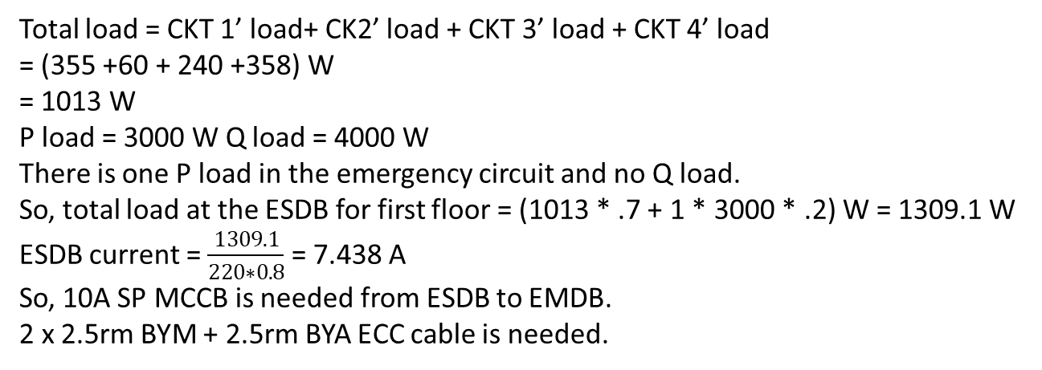
Calculations for ESDB (1st to 5th Floor)
Total load = CKT 1’ load+ CK2’ load + CKT 3’ load + CKT 4’ load
= (355 +60 + 240 +358) W
= 1013 W
P load = 3000 W Q load = 4000 W
There is one P load in the emergency circuit and no Q load.
So, total load at the ESDB for first floor = (1013 * .7 + 1 * 3000 * .2) W = 1309.1 W
ESDB current = $\frac{1309.1}{220∗0.8}$ = 7.438 A
So, 10A SP MCCB is needed from ESDB to EMDB.
2 x 2.5rm BYM + 2.5rm BYA ECC cable is needed.
Project Group 8

Slide 33
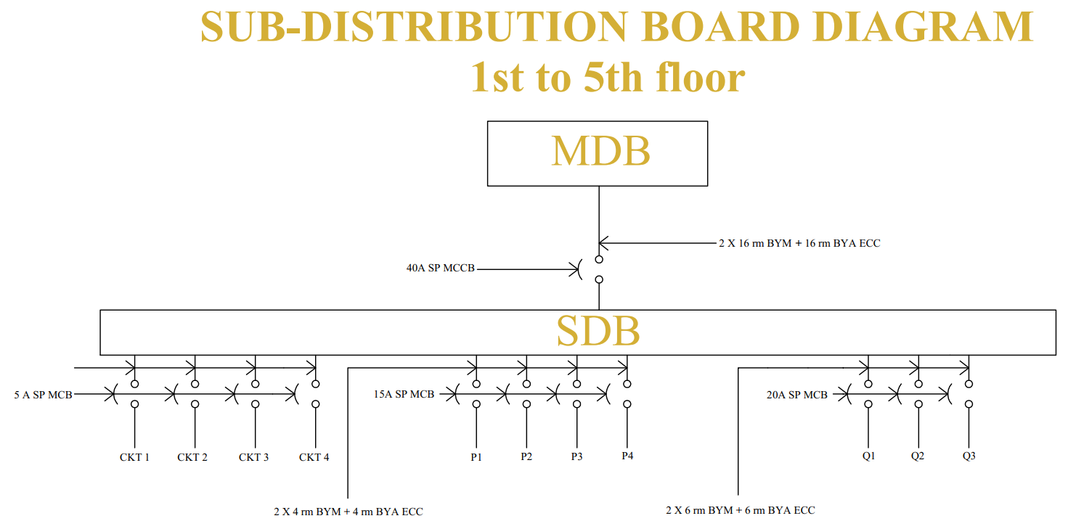
Project Group 8

Slide 34
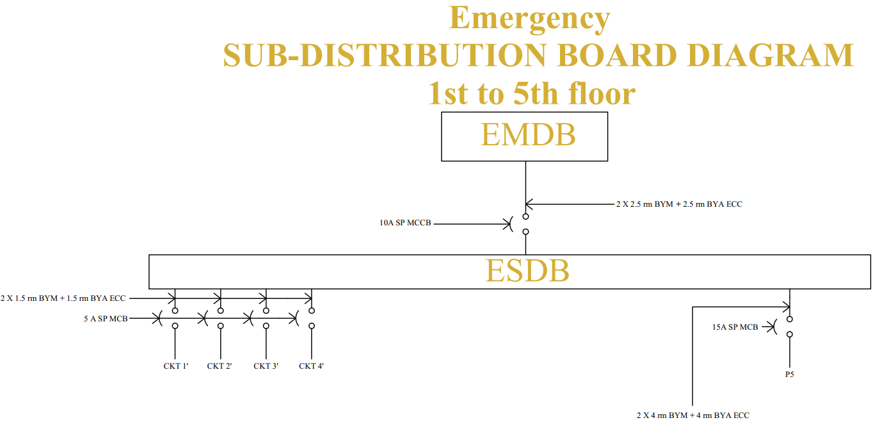
Project Group 8

Slide 35
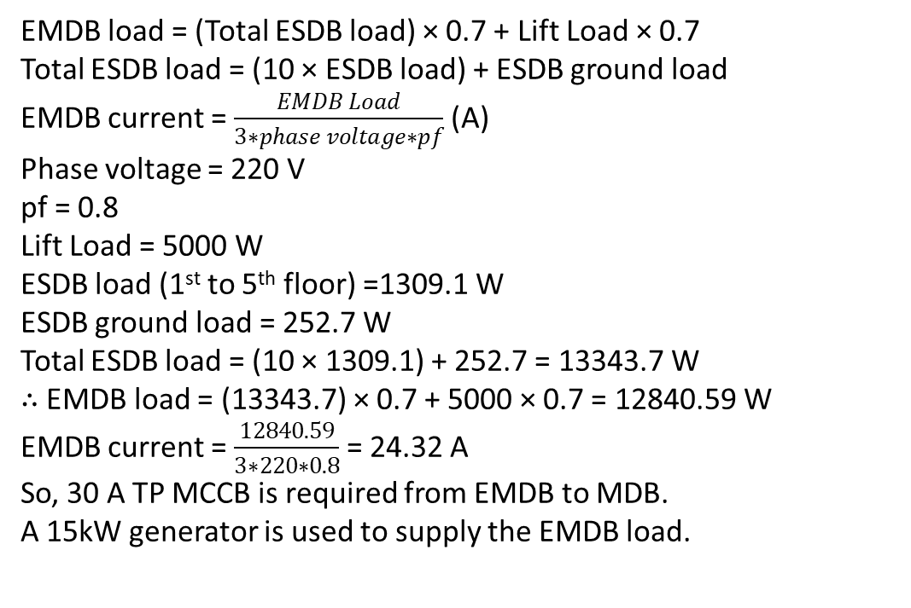
Calculations for EMDB:
EMDB load = (Total ESDB load) × 0.7 + Lift Load × 0.7
Total ESDB load = (10 × ESDB load) + ESDB ground load
EMDB current = $\frac{EMDB Load}{3∗phase voltage∗pf}$ (A)
Phase voltage = 220 V
pf = 0.8
Lift Load = 5000 W
ESDB load (1st to 5th floor) =1309.1 W
ESDB ground load = 252.7 W Total ESDB load = (10 × 1309.1) + 252.7 = 13343.7 W
∴ EMDB load = (13343.7) × 0.7 + 5000 × 0.7 = 12840.59 W
EMDB current = $\frac{12840.59}{3∗220∗0.8}$ = 24.32 A
So, 30 A TP MCCB is required from EMDB to MDB.
A 15kW generator is used to supply the EMDB load.
Project Group 8

Slide 36
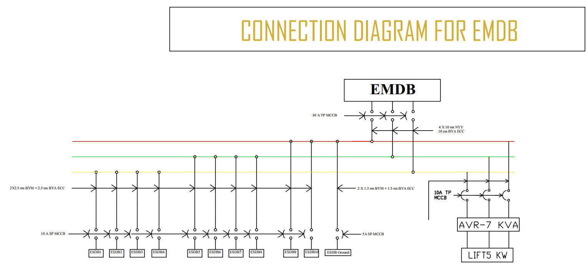
Project Group 8

Slide 37
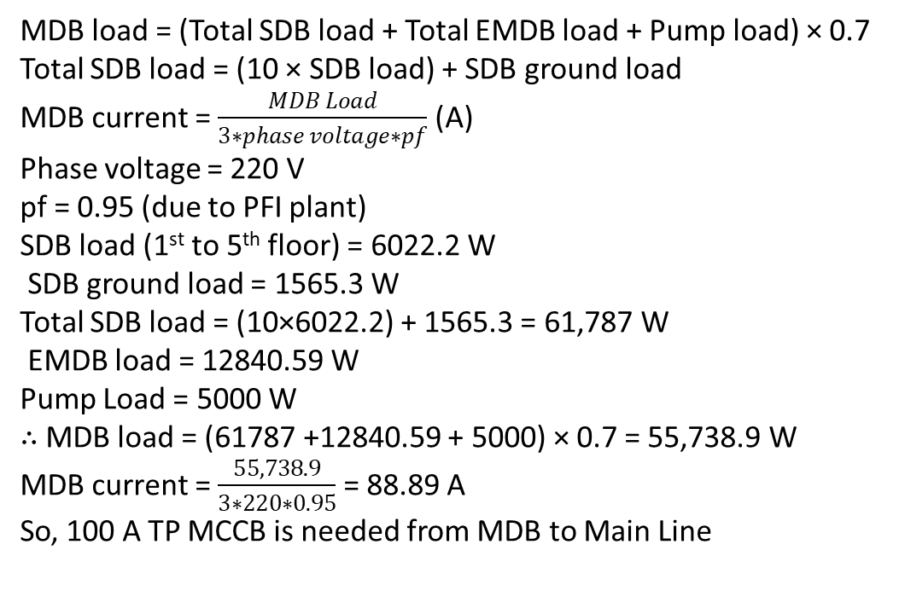
Calculations for MDB:
MDB load = (Total SDB load + Total EMDB load + Pump load) × 0.7
Total SDB load = (10 × SDB load) + SDB ground load
MDB current = $\frac{MDB Load}{3∗phase voltage∗pf}$ (A)
Phase voltage = 220 V
pf = 0.95 (due to PFI plant)
SDB load (1st to 5th floor) = 6022.2 W
SDB ground load = 1565.3 W
Total SDB load = (10×6022.2) + 1565.3 = 61,787 W
EMDB load = 12840.59 W
Pump Load = 5000 W
∴ MDB load = (61787 +12840.59 + 5000) × 0.7 = 55,738.9 W
MDB current = $\frac{55,738.9}{3∗220∗0.95}$ = 88.89 A
So, 100 A TP MCCB is needed from MDB to Main Line
Project Group 8

Slide 38
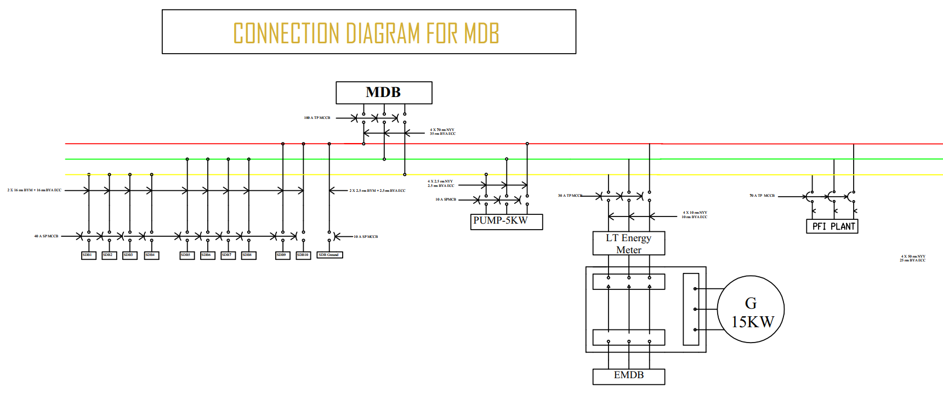
Project Group 8

Slide 39
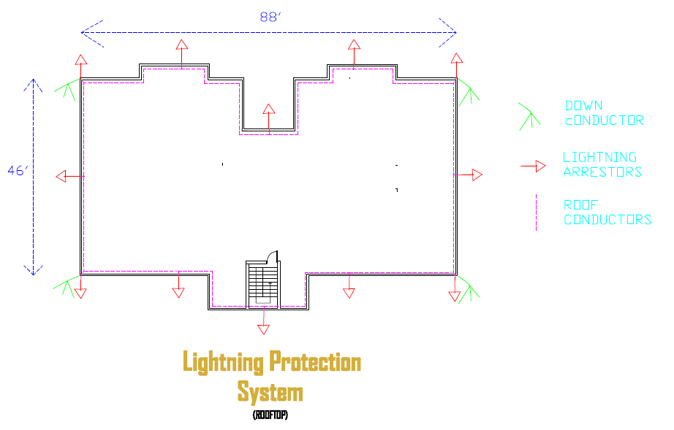
Lightning Protection System
Index Calculation :
Use of Structure : index = 4
Type of Construction : Index = 4
Contents or Consequential effects: index = 2
Degree of Isolation : Index = 5
Type of Terrain : index = 2
Height of structure : 60ft(10*6) = 18.288 meter. So index = 8
Lightning Prevalence : index = 11
Total = 36 < 40
So actually, for the building the lightning protection system is not necessary. We will design it anyway.
Project Group 8

Slide 40
Lightning Protection System Design Parameters:
Number of Air Terminal Calculation:
Linear Length = 88 ft and Linear Width = 46 ft
Length of the roof is 88 ft. The air terminals at the side can be 25’ apart at maximum. So we need 3 air terminals (in total 6) in between for each side of the length. Width of the roof is 46 ft. So one air terminal(2 total 2) in between of the edges can match the requirements for both width sides.
So total number of Air Terminal = (3*2+1*2+1*4) = 12
Down Conductors:
Total Area = 88*46 sq ft = 4048 sq-ft = 376.1 sq-m
Number of down conductors = (376.1/100) = 3.76
So we have used 4 down conductors at the 4 corners of the roof..
Roof Conductors:
We have placed roof conductors 8” away from the roof railing connecting all the Air Terminals and Down Conductors.
Project Group 8

Slide 41
¡Muchas Gracias!
Project Group 8

